Slide 1



Coffee Orders Analysis

Slide 2


Agenda
Project Recap
Problem
Process
Insight
Action Plan

Slide 3

Project Recap
The coffee shop are facing revenue problem, they need detailed analysis and identify areas for improvement in their marketing strategies.

Slide 4
Problem
Analysis of the customer information
Sales comparision of different type of products
The sales trend in different time

Slide 5
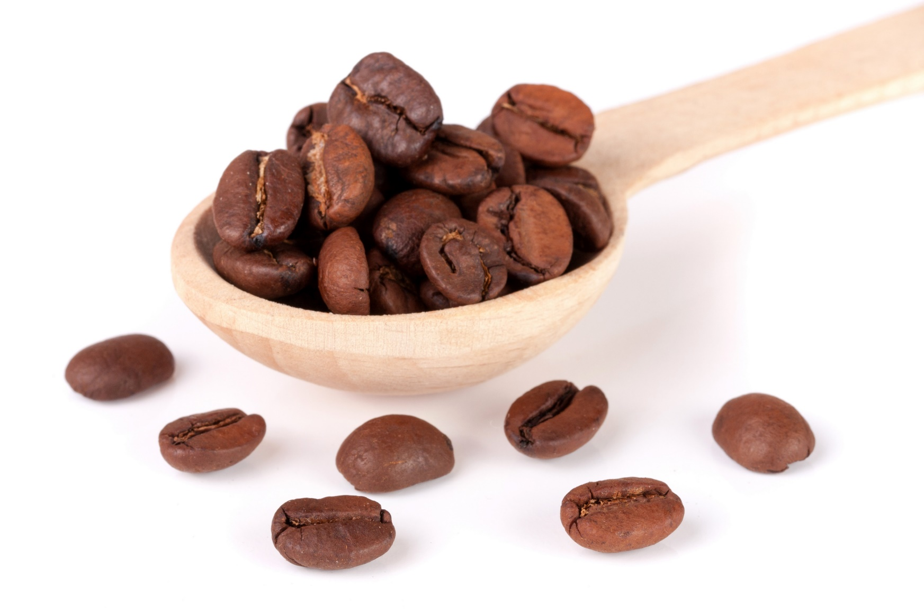
Process
1.Data Understanding
2.Data Transforming
3.Data Analysis
4.Business Decisions

Slide 6
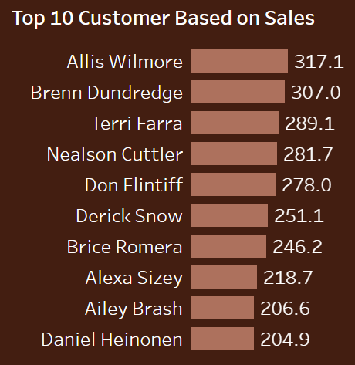
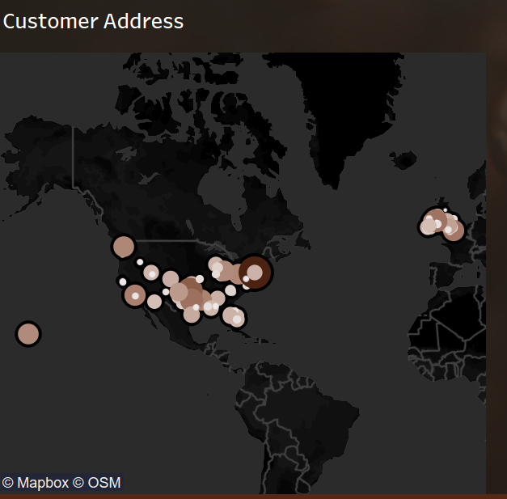
Customer
Most customers are from America and the UK

Slide 7
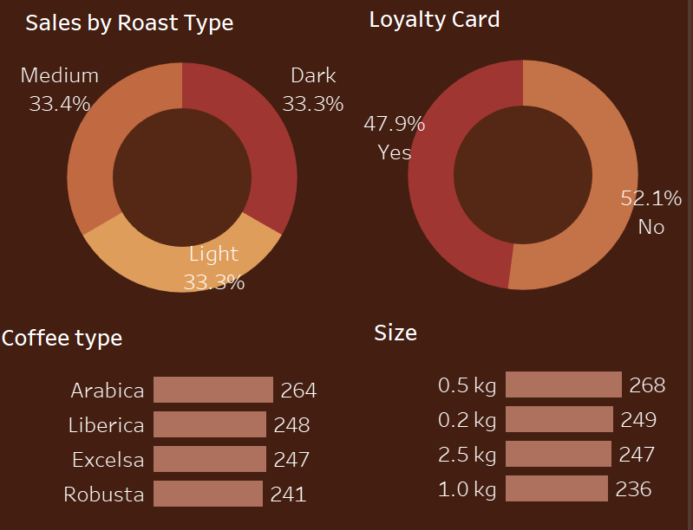
Loyalty Card
1
More than half people don't use Loyalty Card
Different Product
2
Customers don’t show obvious preference on different roasts.

Slide 8
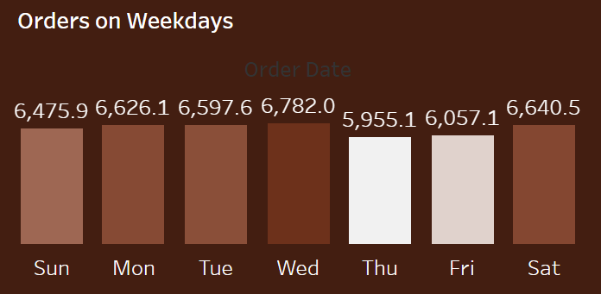
Sales Trend on Weekdays
The busiest days are Wedesday and Saturday，most sales are recorded on Wedesday. On Thusday, the shop is not busy, the least sales are recorded on that day.

Slide 9



Action Plan
capitalize on 0.5kg roast and Aribica coffee
provide more discounts to attract more people using Loyalty Card.
design different kinds of products
cut cost on Tuesday

Slide 10
THANK YOU

